Slide 2
Data types
a data type is a classification of data that determines the type of values that can be assigned to a variable,
There are two types of data types categories
1. Primitives data types:
Boolean, byte, short, int, long, float, double, char, etc.
2. Non-Primitives:
Arrays, Array List, Set, Has Map, etc.

Slide 3
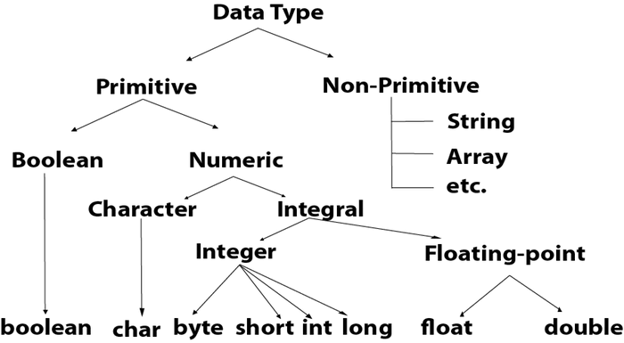
Types of data types

Slide 4
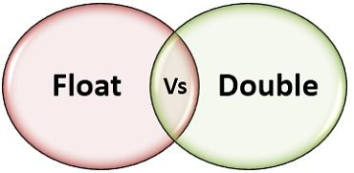
Float V/S Double

Slide 5
Float data type
It includes a fraction represented in decimal format
The float data type is a single-precision 32-bits or 4-bytes
Sufficient for less than storing 7 decimal digits
For example: float = f;
f = 123.65049f;
Temperature 32.5 degrees

Slide 6
Double data type
It also includes a fraction represented in decimal format
The double data type is double-precision 64-bits or 8-bytes
Sufficient for more than storing 7 decimal digits
For example: double = d;
d = 123.568455d;
* Accurate interest amount Rs. 1250.166434333

Slide 7
Different between Float & Double
Feature | Float | Double
Range | Smaller range of values than double | Larger range of values than float
Memory Usage | Takes up less memory than double | Takes up more memory than float
Speed | Operations can be faster than double on some platforms | Operations can be slower than float on some platforms
Usage | Used when high precision is not required or when memory usage is a concern | Used when high precision is needed or a wider range of values is required
Example
Float f = 123.9999f;
Double d = 1510.1234433353d;

Slide 8
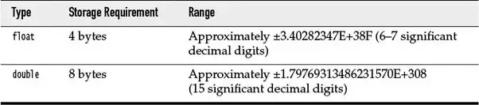
Float vs Double

Slide 9
Thank you

